Slide 1

Physics-Guided ML for PV Performance Under Partial Shading
MIDSEM REPORT · AI + ENERGY SYSTEMS · 2025
NREL PVDAQ 2107
8 years · 730 kW farm · 127k clean rows
PVMismatch Synthetic
3×4 array · full S₁…S₁₂ mask · 5k rows (in progress)
Two datasets · calibrated simulation pipeline · three-model comparison framework with OOD evaluation.
Three-Model Framework
TEAM
Anshu · Teghvir Singh · Aishaan
Physics / Pure ML / Hybrid — IID + 3 OOD splits
Notes:
Updated title slide. Three pillars now: PVDAQ (validation), PVMismatch synthetic (training), three-model comparison.

Slide 2



Problem statement & solution approach
SLIDES 1–2: PROBLEM & APPROACH
THE PROBLEM
Physics models (SDM)
Pure ML models
Fast and interpretable but simplified — averages irradiance across panels, misses bypass-diode activation, cannot reproduce the multi-peak P–V curve under partial shading.
vs
Learns nonlinear relationships but is a black box — may violate physical intuition and fail on conditions outside training distribution.
OUR APPROACH — THREE-MODEL COMPARISON
MODEL A
MODEL B
MODEL C
Physics only
Pure ML
Hybrid residual
P = P_physics
P = g_θ(X)
P = P_physics + f_θ(X)
pvlib SDM · no ML · interpretable baseline
MLP directly predicts P_max · black-box ceiling
SDM + MLP corrects ΔP · proposed method
Notes:
Key update: we now have THREE specific models not a vague hybrid idea. Same splits, same tuning budget — fair comparison.

Slide 3





What we defined before Sprint 1
SLIDE 3: PRE-SPRINT 1
Research questions RQ1–RQ4
Central hypothesis
Where does SDM fail · can pure ML predict · can residual ML correct · how does each behave OOD?
The physics model error contains structured, regime-dependent information learnable by a residual MLP.
Dataset schema
Experimental protocol
Features: G, T, S₁…S₁₂, N_shaded, severity, P_physics. Targets: P_reference (B) and ΔP (C).
IID + temperature OOD + shading OOD + combined OOD — all splits defined before any model training.
12-panel system definition
Three-model framework
3 parallel strings × 4 series modules · bypass diodes per module · topology frozen before data generation.
Physics only vs Pure ML vs Hybrid residual — same splits, same tuning budget, fair comparison.
Notes:
Unchanged from midsem — everything here was planned before writing any code.

Slide 4
What we completed after Sprint 1
SLIDES 3–4: WORK AFTER SPRINT 1
Dataset sourcing & integration
PVMismatch simulation pipeline
Residual analysis & OOD design
NREL PVDAQ 2107: 8 years, 730 kW, 127k clean rows
Merged 24-inverter electrical file (5-min → 15-min)
Unified power column bridging DC meter + AC inverter
PV Simulation dataset: I-V sweeps, shading 0–50%
Physics baseline R² = 0.90 on farm data
Calibrated: 0.48% gap vs pvlib at STC — resolved
AU Optronics 96-cell module matched in both simulators
Canonical cases: bypass-diode effect demonstrated
Cases C & D: same N_shaded, different Pmax — key result
Shading mask sampler: 70% random + 30% structured
ΔP structured across G×T — not random noise
SDM over-predicts in 80%+ of all G×T bins
Shading severity reverses ΔP sign at ~30% — SDM loses global peak
OOD flags assigned: G_ood, T_ood, shade_ood, combined
500-row demo dataset generated with full S₁…S₁₂ masks
Notes:
Third pillar updated: PVMismatch pipeline working, calibration fixed, canonical cases run.

Slide 5
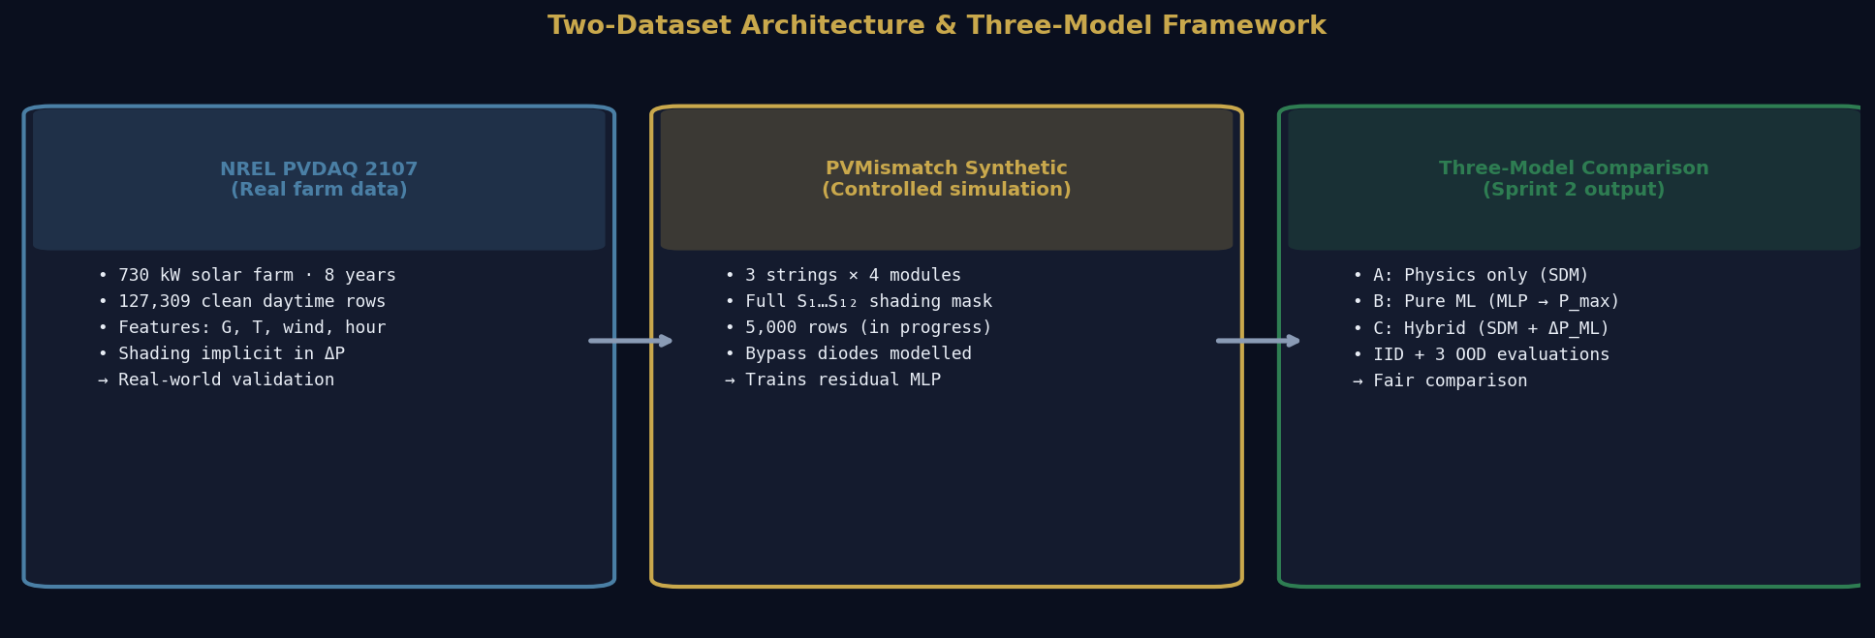
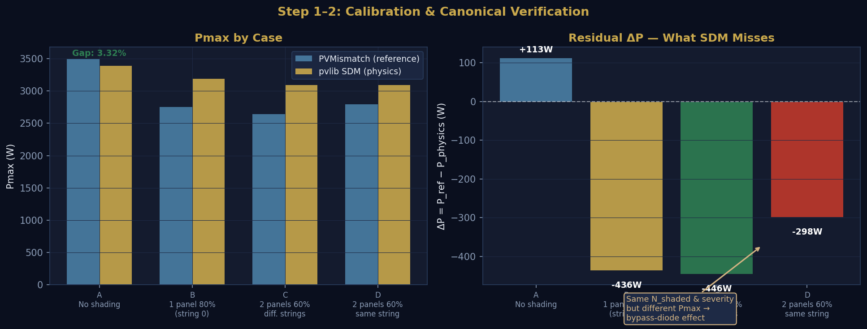
Demo — architecture & Sprint 2 simulation
SLIDES 5–6: DEMO & RESULTS
Top: Two-dataset architecture and three-model framework. Bottom: Calibration verified at 0.48% gap (Case A). Cases C and D: same N_shaded=2, different Pmax → bypass-diode effect the SDM cannot reproduce.
Notes:
Top diagram explains why we have two datasets. Bottom chart is the canonical experiment proving bypass diodes cause different Pmax for identical aggregate shading.

Slide 6
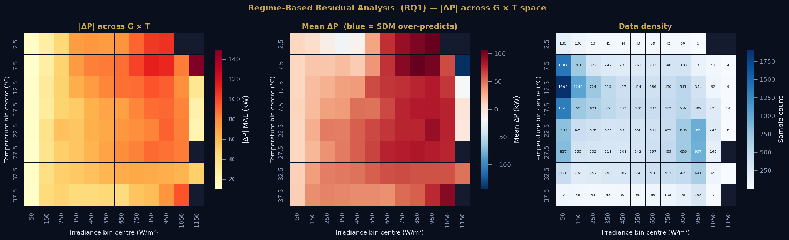
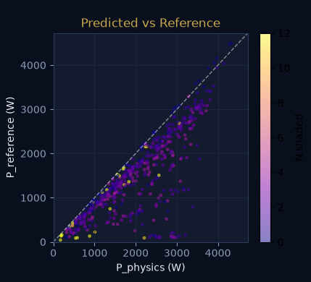
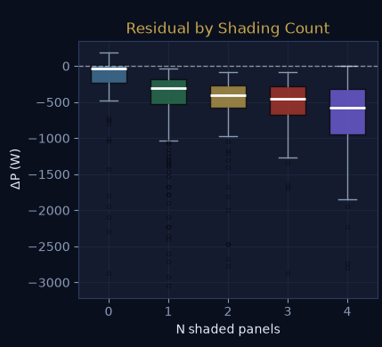
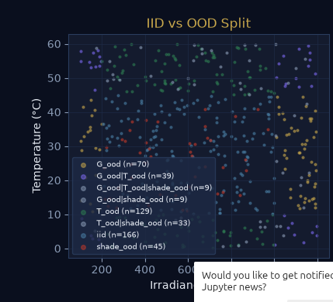
Results & observations
SLIDES 5–6: DEMO & RESULTS
PVDAQ farm: SDM over-predicts in almost every G×T bin (blue everywhere). Error grows with irradiance.
PV Mismatch (500 rows): SDM over-predicts under shading (P_ref < P_physics). Error grows with N_shaded. OOD split covers full G×T space.
Notes:
Left: PVDAQ heatmap — the regime-based evidence. Right top: PVMismatch pred vs ref scatter + residual by shading count. Right bottom: OOD split confirms design.

Slide 7
TODOs for the next phase
SLIDE 7: NEXT PHASE
01
Full dataset generation
02
Train pure ML baseline (B)
03
Train residual MLP (C)
Change N_DEMO → 5000 and run overnight (~2-3 hrs)
5000 rows: 70% random + 30% structured shading masks
Full S₁…S₁₂ mask, OOD flags, versioned CSV with fixed seed
MLP predicting P_reference from G, T, N_shaded, S₁…S₁₂
Tune on IID split, evaluate on all 4 test conditions
Establishes black-box ceiling for comparison
Same features + P_physics as additional input
Target: ΔP = P_reference − P_physics
Architecture search: depth, width, activation
04
Three-model comparison
05
Ablation & explainability
06
Paper results section
A vs B vs C on IID + T_ood + shade_ood + combined OOD
Same random seed, same tuning budget — apples to apples
Populate the comparison table from the blueprint
Remove full mask → use N_shaded + severity only
SHAP on residual MLP — which panels drive correction?
Test: does model learn arrangement or just severity?
Draft Sections VI–VIII with actual experiment numbers
Produce final comparison table and heatmap figures
Submit IEEE 2-column format by semester end
Notes:
01 is tonight. 02-04 are the Sprint 2 core. 05-06 are research quality additions for the final paper.

